Slide 1
Card-inal Sin
Devon Grant, Long Hoang, Matt Izzo, Sara Earl

Slide 2
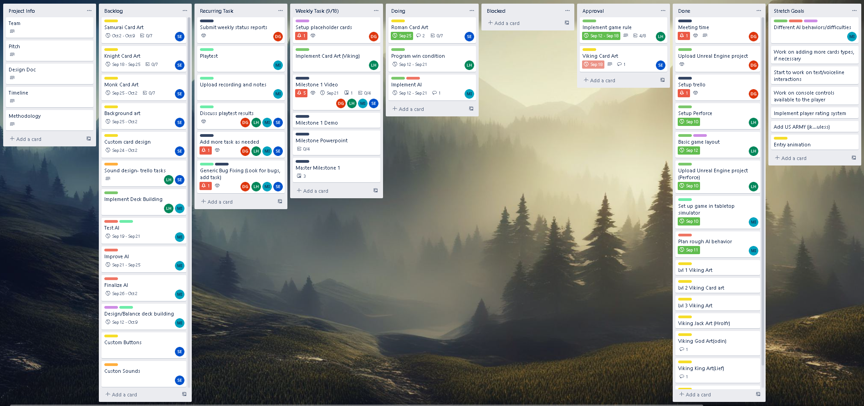
Project Management
Organizational Structure
Trello
Color Coordinated
Divided by task
Subdivisions
Are used to better convey progression to the rest of the team
Allow for a more granular look at the weekly progression of the team as well as manage expectations regarding such

Slide 3
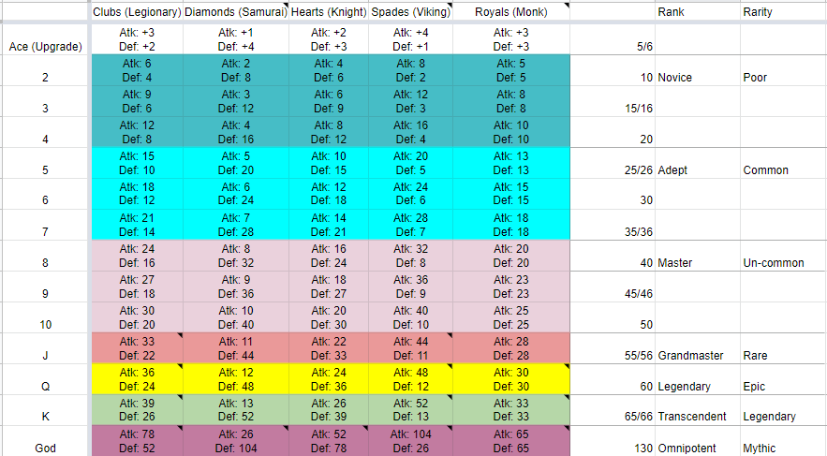
Game Design
Card Balance & Rules
Set Up
Both players draw three cards from their deck and place them face up on the field
Both players then draw three additional cards to keep in their hand
Who goes first
The player with the lowest summed card rank on the field goes first
Combat
On the player's turn they may use one of their cards on the field to attack one of their opponents cards, damage of the attacking card is applied to the target card, and visa versa.
Card death
If a card dies on the field, use one of the three cards in your hand to bring the total cards on your field back to three, if you have no cards left in your hand disregard this step
Drawing
Players may draw a card from their deck if the amount of cards in their hand fall below three, if you can no cards left in your deck disregard this step
Win Condition
Winner is determined when a player runs out of cards

Slide 4


General Programming
Source Control: Perforce
Chosen Perforce because it’s integrated into UE4
Hosted on Amazon AWS server
Used P4V for managing the server
Developers can use the integrated Perforce tool in UE4 for editing then submit it to the server

Slide 5
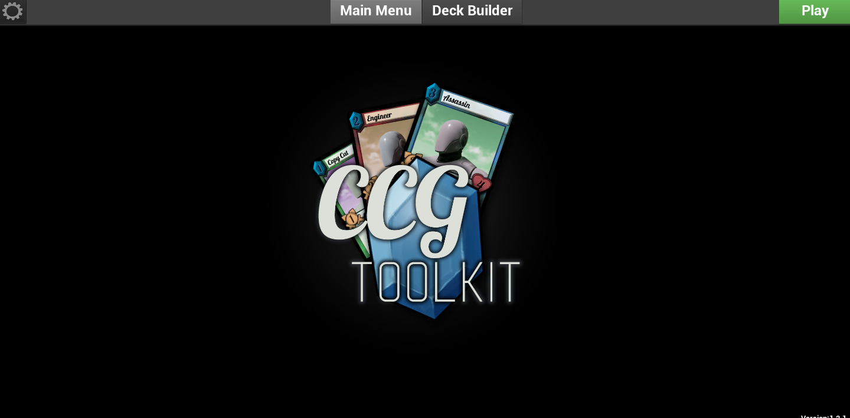
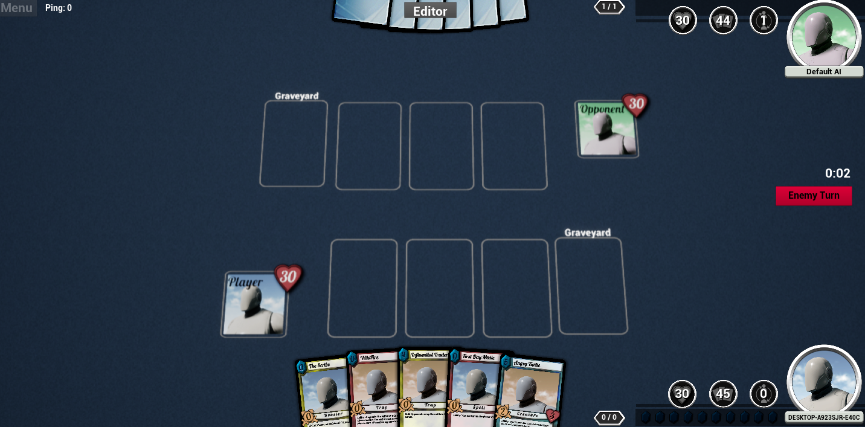
General Programming
Gameplay and playmat layout
Used CCG Toolkit as a framework for development
Basic functionalities are already implemented
Can focus on game design, balancing and implementing new mechanics
Implemented playmat layout and basic game mechanics

Slide 6
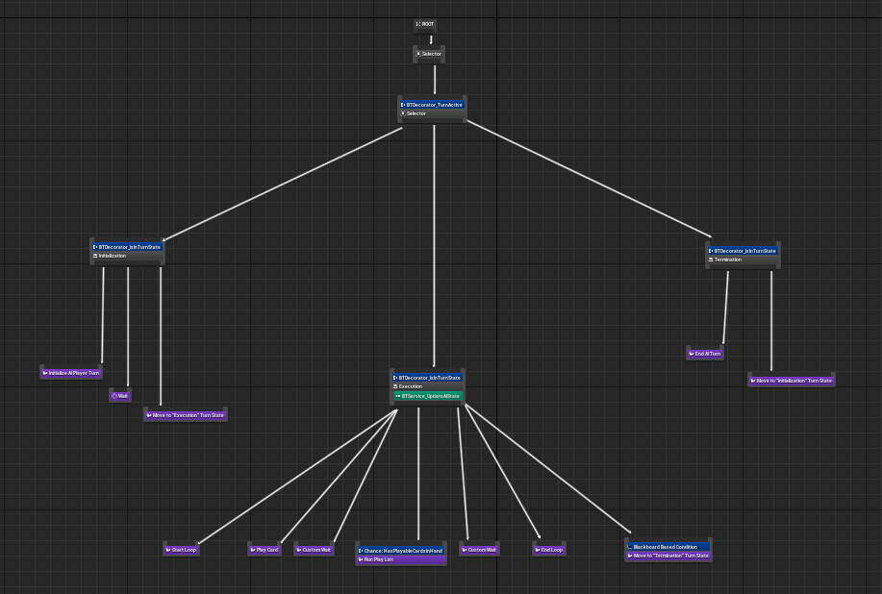
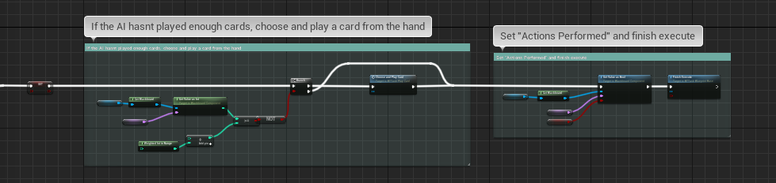
AI Programming
CCG Toolkit has base AI which can be altered
Unreal Behavior Tree
Designed AI by playing PvP against playtesters

Slide 7
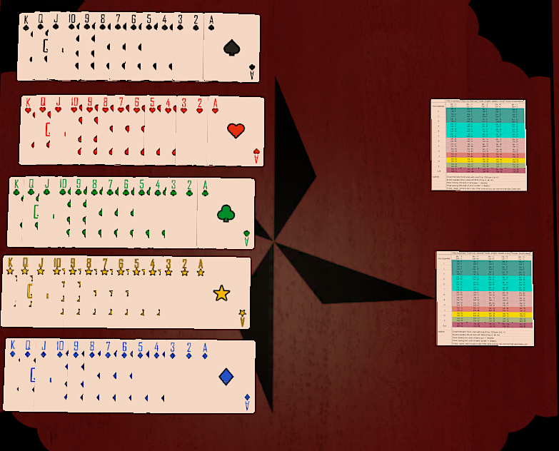
Quality Assurance
Set up a TableTop Simulator game
Tested card balancing
Future playtests in Unreal
Tested current Unreal project

Slide 8




Art Design
Card art completed for Viking Faction
Featuring 3 similar sprites for the 3 tiers of base units
Additionally, 4 unique ‘noble’ cards
Pixel art style chosen for ease of production
80x80 canvas size

Slide 9
Retrospective
(perforce issues)
(art delays)

Slide 10
Whats Next
More art, attempting to cover the other faction cards.
More playtest for balancing and new ideas
Add custom abilities and mechanics

Slide 11
Q&A

Slide 12
If you've seen this slide you've gone too far, turn back now
Links:
https://github.com/Long-T-Hoang/CardinalSin
https://drive.google.com/file/d/1DPOKRQQY8cbBC49xW-jDDzRwPom6JkaM/view?usp=sharing

